Slide 1
Introduction to JFC Swing

Slide 2
Agenda
Introduction
About JFC and Swing
Pluggable Look and Feel
Swing Components
Borders
Layout Management
Events Handling
Notes:
The Java Foundation Classes (JFC) are a graphical framework for building portable Java-based graphical user interfaces (GUIs). JFC consists of the Abstract Window Toolkit (AWT), Swing and Java 2D. Together, they provide a consistent user interface for Java programs, regardless whether the underlying user interface system is Windows, Mac OS X or Linux.

Slide 3
AWT to Swing
AWT: Abstract Windowing Toolkit
    import java.awt.*
Swing: new with Java2
    import javax.swing.*
    Extends AWT
    Tons o’ new improved components
    Standard dialog boxes, tooltips, …
    Look-and-feel, skins
    Event listeners
API:
    http://java.sun.com/j2se/1.3/docs/api/index.html
Notes:
AWT existed before JFC. AWT was heavily criticized for being little more than a wrapper around the native graphical capabilities of the host platform. That meant that the standard widgets in the AWT relied on those capabilities of the native widgets, requiring the developer to also be aware of the differences between host platforms.
Using the Java programming language, Java Foundation Classes (JFC) are pre-written code in the form of class libraries (coded routines) that give the programmer a comprehensive set of graphical user interface (GUI) routines to use. The Java Foundation Classes are comparable to the Microsoft Foundation Class (MFC) library. JFC is an extension of the original Java Abstract Windowing Toolkit (AWT). Using JFC and Swing, an additional set of program components, a programmer can write programs that are independent of the windowing system within a particular operating system.

Slide 4
Getting started with Swing
Swing, like the rest of the Java API is subdivided into packages:
  javax.swing, javax.accessibility, javax.swing.border …
At the start of your code - always
  import javax.swing;
  import javax.swing.event;
Most Swing programs also need
  import java.awt.*;
  import java.awt.event.*;
Notes:
Buttons and labels can display images
Behaviour and appearance of components
Component shape
Borders
Assistive technologies
Look and feel of the program’s GUI
Windows – (but only on Windows, M$ issues….)
UNIX
GTK
etc

Slide 5
A typical Swing program
Consists of multiple parts
  Containers
  Components
  Events
  Graphics
  (Threads)

Slide 6
About JFC and Swing
JFC – JavaTM Foundation Classes
Encompass a group of features for constructing graphical user interfaces (GUI).
Implemented without any native code.
“Swing” is the codename of the project that developed the first JFC components .
The name “Swing” is frequently used to refer to new components and related API.

Slide 7
About JFC and Swing
Swing features:
  The Swing Components
    Dialog, Tabbed pane, Buttons, File Chooser, ...
  Pluggable Look and Feel
  Accessibility API
    Screen readers, Braille displays, ...
  Java 2DTM API
  Drag and Drop
    Between Java applications and native applications.

Slide 8



Pluggable Look and Feel
Each picture shows the same program but with a different look and feel

Slide 9
Swing Components
Swing provides many standard GUI components such as buttons, lists, menus, and text areas, which you combine to create your program's GUI.
Swing provides containers such as windows and tool bars.
  top level: frames, dialogs
  intermediate level: panel, scroll pane, tabbed pane, ...
  other Swing components: buttons, labels, ...
A visual index of Swing components

Slide 10
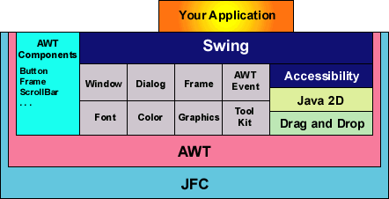
OTHER APIs

Slide 11
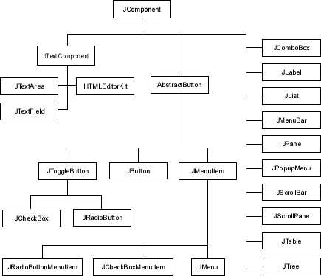
UI COMPONENTS

Slide 12
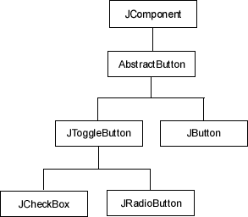

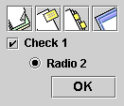


BUTTONS

Slide 13
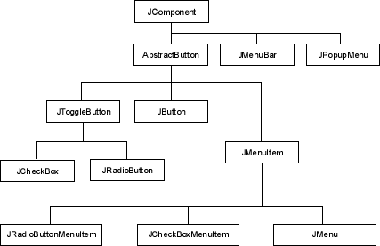
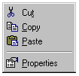




MENUS
JMenuBar

Slide 14


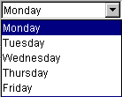
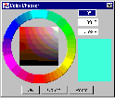

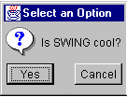
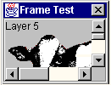
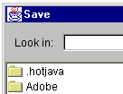
OTHER COMPONENTS
JApplet
Border Interface
JComboBox
JColorChooser
ImageIcon
JInternalFrame
JDialog
JFileChooser

Slide 15





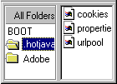
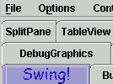
OTHER COMPONENTS
JLabel
JList
JScrollBar
JScrollPane
JOptionPane
JSlider
JSplitPane
JTabbedPane

Slide 16


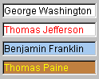



OTHER COMPONENTS
JTable
JTextArea
JTextField
JToolBar
JToolTip
JTree

Slide 17
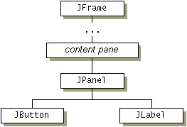
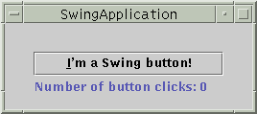
A simple Swing program - Containers

Slide 18
Containers
Descendents of the java.awt.Container class
Components that can contain other components.
Use a layout manager to position and size the components contained in them.
Components are added to a container using one of the various forms of its add method
  Depending on which layout manager is used by the container

Slide 19
Remember this about Containers:
The structure of containers is your design decision and should always be thought through in advance
  particularly for managing components
  nesting containers
Failure to do so usually either results in a messy interface, messy code or both.

Slide 20
Top Level Containers
Every program that presents a Swing GUI contains at least one top-level container.
A Top level container provides the support that Swing components need to perform their painting and event-handling.
Swing provides three top-level containers:
  JFrame (Main window)
  JDialog (Secondary window)
  JApplet (An applet display area within a browser window)

Slide 21
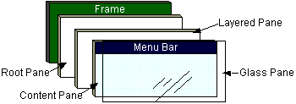
Top Level Containers (cont)
To appear on screen, every GUI component must be part of a containment hierarchy, with a top-level container as its root.
Each top-level container has a content pane that contains visible components in that top-level container’s GUI.
Don’t add a component directly to a top-level container.

Slide 22
Frames
Frame is a window that is not contained inside another window. Frame is the basis to contain other user interface components in Java GUI applications.
The Frame class can be used to create windows.
For Swing GUI programs, use JFrame class to create widows.

Slide 23
JFrame
A frame implemented as an instance of the JFrame class, is a window that has decorations such as a border, a title and buttons for closing and iconifying the window.
  The decorations on a frame are platform dependent.
Applications with a GUI typically use at least one frame.

Slide 24
Creating Frames
  import javax.swing.*;
  public class MyFrame {
  public static void main(String[] args) {
  JFrame frame = new JFrame("Test Frame");
  frame.setSize(400, 300);
  frame.setVisible(true);
  frame.setDefaultCloseOperation(
  JFrame.EXIT_ON_CLOSE);
  }
}

Slide 25
Centering Frames
By default, a frame is displayed in the upper-left corner of the screen. To display a frame at a specified location, you can use the setLocation(x, y) method in the JFrame class. This method places the upper-left corner of a frame at location (x, y).

Slide 26
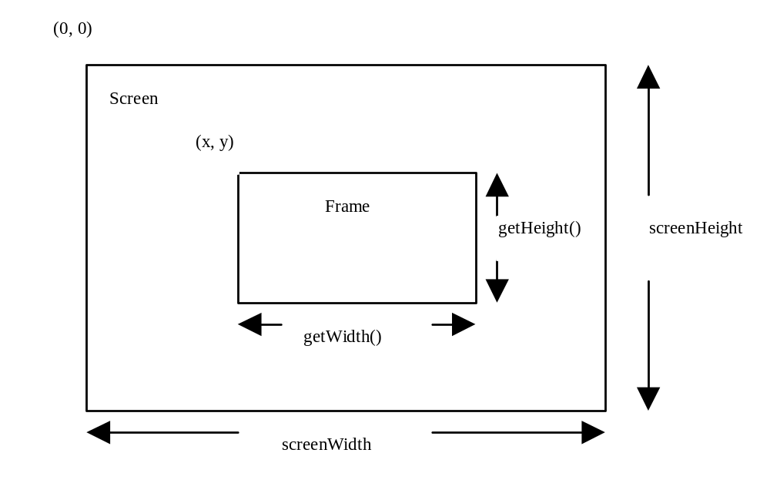
Centering Frames, cont.

Slide 27
Adding Components into a Frame
  // Add a button into the frame
  frame.getContentPane().
  add( new JButton("OK"));

Slide 28
content pane
The content pane is a subclass of Container.
You may wonder how a content pane object is created. It is created when a JFrame object is created.
A JFrame object uses the content pane to hold components in the frame.
Notes:
The statement in the preceding slide can be replaced by the following two lines:
Container container = frame.getContentPane();
container.add(new JButton("OK"));

Slide 29
Intermediate Level Containers
Also known as panels or panes
Simplify the positioning of other components.
  JPanel
Play a visible and interactive role in a program’s GUI
  JScrollPane
  JTabbedPane

Slide 30
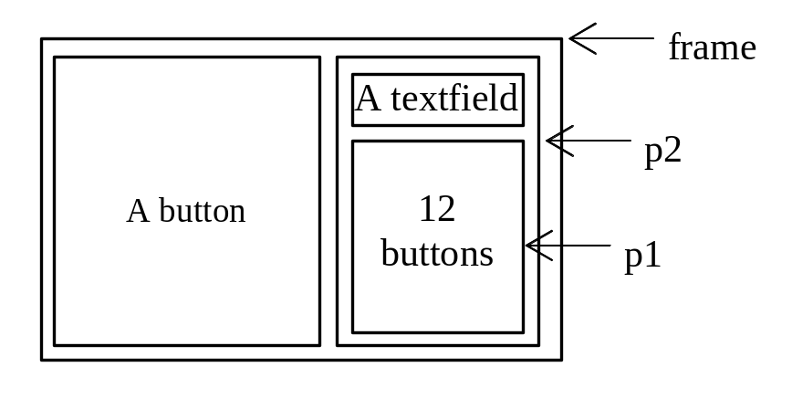
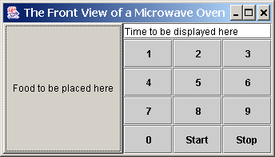
Panel
Use panels to organize components. The program creates a user interface for a Microwave oven.

Slide 31
Intermediate Level Containers
By default, panels don’t paint anything except for their background.
By default, panels are opaque.
  An opaque panel can be set as a top-level container’s content pane.
  transparent (non-opaque) panels draw no background.

Slide 32
Using a GUI Component
Create it
    Instantiate object: b = new JButton(“press me”);
Configure it
    Properties: b.text = “press me”; [avoided in java]
    Methods: b.setText(“press me”);
Add it
    panel.add(b);
Listen to it
    Events: Listeners

Slide 33
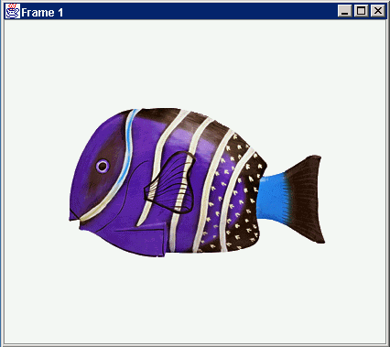
Anatomy of an Application GUI
GUI
Internal structure
JFrame
JFrame
JPanel
containers
JPanel
JButton
JButton
JLabel
JLabel

Slide 34
Using a GUI Component 2
Create it
Configure it
Add children (if container)
Add to parent (if not JFrame)
Listen to it
order
important

Slide 35
Build from bottom up
Listener
Create:
    Frame
    Panel
    Components
    Listeners
Add: (bottom up)
    listeners into components
    components into panel
    panel into frame
JLabel
JButton
JPanel
JFrame

Slide 36
Application Code
import javax.swing.*;
class hello {
public static void main(String[] args){
JFrame f = new JFrame(“title”);
JPanel p = new JPanel();
JButton b = new JButton(“press me”);
p.add(b); // add button to panel
f.setContentPane(p); // add panel to frame
f.setVisible(true);
}
}
press me

Slide 37
JDialog
Every dialog is dependent on a frame
  Destroying a frame destroys all its dependent dialogs.
  When the frame is iconified, its dependent dialogs disappear from the screen.
  When the frame is deiconified, its dependent dialogs return to the screen.
A dialog can be modal. When a modal dialog is visible it blocks user input to all other windows in the program.

Slide 38
Jdialog
To create custom dialogs, use the JDialog class directly (as in the previous examples).
Swing provides several standard dialogs
  JProgressBar, JFileChooser, JColorChooser, ...
The JOptionPane class can be used to create simple modal dialogs
  icons, title, text and buttons can be customized.

Slide 39
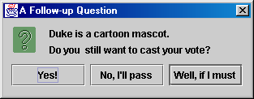
Example
  Object[] options = {"Yes!", "No, I'll pass",
  "Well, if I must"};
  int n = JOptionPane.showOptionDialog(
  frame, "Duke is a cartoon mascot. \n" +
  "Do you still want to cast your vote?",
  "A Follow-up Question",
  JOptionPane.YES_NO_CANCEL_OPTION,
  JOptionPane.QUESTION_MESSAGE,
  null,
  options,
  options[2]);

Slide 40
JComponent
JComponent is the base class for all Swing components except top-level containers.
  JLabel, JButton, JList, JPanel, JTable, ...
To use a component that inherits from JComponent, it must be placed in a containment hierarchy who’s base is a top-level container.

Slide 41
JComponent (cont)
The JComponent class provides the following (partial list):
  Pluggable Look & Feel
  Keystroke handling
  Tooltip support
  Accessibility
  An infrastructure for painting
  Support for borders.
All descendents of JComponent are also Containers
  A JButton can contain text, icons etc.

Slide 42
Borders
Every JComponent can have one or more borders.
The class BorderFactory may be used to create standard borders
pane.setBorder(BorderFactory.
createLineBorder(Color.black));
Using a compound border, you can combine any two borders, which can themselves be compound borders
BorderFactory.createCompoundBorder(border1, border2);

Slide 43
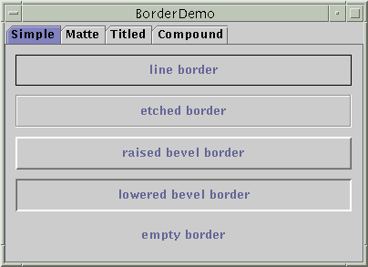
Simple Borders

Slide 44
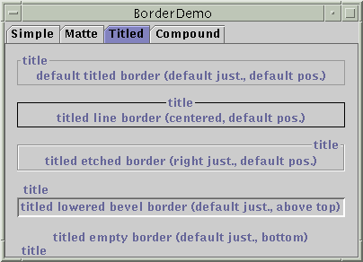
Titled Borders

Slide 45
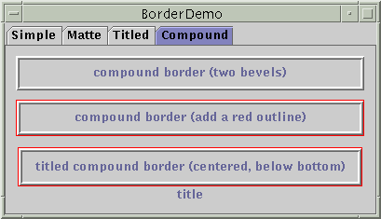
Compound Border

Slide 46
Layout Management
The process of determining the size and position of components.
Layout management can be done using absolute positioning
  Size and position of every component within the container must be specified.
  Does not adjust well when the top-level container is resized.
  Does not adjust well to differences between users and systems, such as font size.

Slide 47
Layout Management (cont)
Layout management is often performed using layout mangers
  Components can provide size and position hints to layout managers, but layout managers have the final say on the size and position of those components.

Slide 48
Layout Management (cont)
Layout hints
  Minimum, preferred and maximum size
  X axis alignment, Y axis alignment
Customizing layout hints
  Invoking setter methods: setMinimumSize, setAlignmentX, ...
  Subclassing and overriding the getter methods: getMinimumSize, getAlignmentX, ...

Slide 49
Layout Management (cont)
The Java platform supplies five commonly used layout managers:
  BorderLayout
  BoxLayout
  FlowLayout
  GridLayout
  GridBagLayout

Slide 50
Layout Manager Heuristics
null
FlowLayout
GridLayout
none,
programmer
sets x,y,w,h
Left to right,
Top to bottom
BorderLayout
CardLayout
GridBagLayout
n
c
One at a time
w
e
JButton
s

Slide 51
Combinations
JButton
JButton
JTextArea

Slide 52
Combinations
JButton
JButton
JFrame
n
JPanel: BorderLayout
c
JPanel: FlowLayout
JTextArea

Slide 53
Code: null layout
JFrame f = new JFrame(“title”);
JPanel p = new JPanel( );
JButton b = new JButton(“press me”);
b.setBounds(new Rectangle(10,10, 100,50));
p.setLayout(null); // x,y layout
p.add(b);
f.setContentPane(p);
press me

Slide 54
Layout Management (cont)
When using the add method to put a component in a container, the container’s layout manager must be taken into account.
A panel’s default layout manager is FlowLayout.
  Other layout managers can easily be set
  panel.setLayout(new BorderLayout());
  Relative position (BorderLayout)
  panel.add(component, BorderLayout.CENTER);
  Order of addition (BoxLayout, GridLayout, ...)
  panel.add(component);

Slide 55

BorderLayout
Has five areas available to hold components
  north, south, east, west and center
All extra space is placed in the center area
  Only the center area is affected when the container is resized.
Default layout manager of content panes.

Slide 56
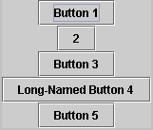
BoxLayout
Places components in a single row (left to right) or column (top to bottom).
Respects component’s maximum size and alignment hints.

Slide 57
FlowLayout
Places components from left to right, starting new rows if necessary.
Default LayoutManager of JPanel

Slide 58

GridLayout
Places components in a requested number of rows and columns.
Components are placed left-to-right and top-to-bottom.
Forces all components to be the same size
  as wide as the widest component's preferred width
  as high as the highest component’s preferred height

Slide 59
Layout Management (cont)
The following factors influence the amount of space between visible components in a container:
  Layout manager
    automatically, user specified, none
  Invisible components
    often used with BoxLayout
  Empty borders
    works best with components that have no default border such as panels and labels.

Slide 60

Example 1
import javax.swing.*;
public class HelloWorldSwing {
public static void main(String[] args) {
JFrame frame = new JFrame("HelloWorldSwing");
final JLabel label = new JLabel("Hello World");
frame.getContentPane().add(label);
frame.setDefaultCloseOperation(JFrame.EXIT_ON_CLOSE);
frame.pack();
frame.setVisible(true);
}
}
pack() causes a window to be sized to fit the preferred size and layouts of its sub-components

Slide 61
Example 2
In this example a custom frame is created
import javax.swing.*;
public class HelloWorldFrame extends JFrame {
public HelloWorldFrame() {
super(“HelloWorldSwing”);
final JLabel label = new JLabel("Hello World");
getContentPane().add(label);
setDefaultCloseOperation(JFrame.EXIT_ON_CLOSE);
pack();
setVisible(true);
}
public static void main(String[] args) {
HelloWorldFrame frame = new HelloWorldFrame();
}}

Slide 62
Menus
Menu Bar
  JMenuBar()
  add( JMenu )
Menu
  JMenu( String )
  add( JMenuItem )
JMenuItem( String )
JMenuItem( String,int )
JMenuBar mb = new JMenuBar(); //create a menu bar
JMenu fileMenu = new JMenu (“File”); //create a menu
mb.add( fileMenu ); //add menu to menu bar
setMenuBar( mb ); // add a menu bar to frame
fileMenu.setMnemonic( KeyEvent.VK_F ); // add a hotkey to menu
JMenuItem miOpen = new JMenuItem( “Open...”, KeyEvent.VK_O );
JMenuItem miExit = new JMenuItem( “Exit” );
fileMenu.add( miOpen ); // add a menu item
fileMenu.addSeparator(); // add a menu separator
fileMenu.add( miExit );

Slide 63
JLabel
Labels
  Provide text instructions on a GUI
  Read-only text
  Programs rarely change a label's contents
  Class JLabel (subclass of JComponent)
Methods
  Can declare label text in constructor
  myLabel.setToolTipText( "Text" )
    Displays "Text" in a tool tip when mouse over label
  myLabel.setText( "Text" )
  myLabel.getText()

Slide 64
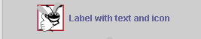
JLabel
Icon
  Object that implements interface Icon
  One class is ImageIcon (.gif and .jpeg images)
    Assumed same directory as program
  Display an icon with JLabel’s setIcon method
    myLabel.setIcon( myIcon );
    myLabel.getIcon //returns current Icon
24 Icon bug = new ImageIcon( "bug1.gif" );
33 label3.setIcon( bug );

Slide 65
1 // Fig. 12.4: LabelTest.java
2 // Demonstrating the JLabel class.
3 import javax.swing.*;
4 import java.awt.*;
5 import java.awt.event.*;
6
7 public class LabelTest extends JFrame {
8 private JLabel label1, label2, label3;
Create a Container object, to which we attach JLabel objects (subclass of JComponent).
9
10 public LabelTest()
11 {
12 super( "Testing JLabel" );
13
Initialize text in JLabel constructor.
14 Container c = getContentPane();
15 c.setLayout( new FlowLayout() );
16
17 // JLabel constructor with a string argument
18 label1 = new JLabel( "Label with text" );
Set the tool tip text, and attach component to Container c.
19 label1.setToolTipText( "This is label1" );
20 c.add( label1 );
21
Create a new ImageIcon (assumed to be in same directory as program).
22 // JLabel constructor with string, Icon and
23 // alignment arguments
24 Icon bug = new ImageIcon( "bug1.gif" );
25 label2 = new JLabel( "Label with text and icon",
26 bug, SwingConstants.LEFT );
27 label2.setToolTipText( "This is label2" );
28 c.add( label2 );
29
Set ImageIcon and alignment of text in JLabel constructor.

Slide 66

Events Handling
Every time a user types a character or pushes a mouse button, an event occurs.
Any object can be notified of an event by registering as an event listener on the appropriate event source.
Multiple listeners can register to be notified of events of a particular type from a particular source.

Slide 67
Types of Event Listeners
Act that results in event | Listener type
User clicks a button, presses Return while typing in a text field, or chooses a menu item | ActionListener
User closes a frame (main window) | WindowListener
User presses a mouse button while the cursor is over a component | MouseListener
User moves the mouse over a component | MouseMotionListener
Component becomes visible | ComponentListener
Component gets the keyboard focus | FocusListener
Table or list selection changes | ListSelectionListener

Slide 68
Implementing an Event Handler
Implement a listener interface or extend a class that implements a listener interface.
Register an instance of the event handler class as a listener upon one or more components.
Implement the methods in the listener interface to handle the event.

Slide 69
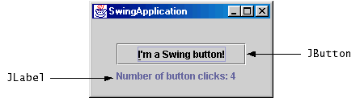
button.addActionListener
button.addActionListener(new ActionListener() {
public void actionPerformed(ActionEvent e) {
numClicks++;
label.setText(labelPrefix + numClicks);
}});

Slide 70
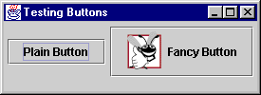
JButton
Methods of class JButton
  Constructors
  JButton myButton = new JButton( "Label" );
  JButton myButton = new JButton( "Label", myIcon );
  setRolloverIcon( myIcon )
    Sets image to display when mouse over button
Class ActionEvent getActionCommand
    returns label of button that generated event
Icon bug1 = new ImageIcon( "bug1.gif" );
fancyButton = new JButton("Fancy Button", bug1 );
fancyButton.setRolloverIcon( bug2 );

Slide 71
JCheckBox
When JCheckBox changes
  ItemEvent generated
    Handled by an ItemListener, which must define itemStateChanged
  Register handlers with with addItemListener
Class ItemEvent
  getStateChange
    Returns ItemEvent.SELECTED or ItemEvent.DESELECTED
private class CheckBoxHandler implements ItemListener {
public void itemStateChanged( ItemEvent e )

Slide 72
1 // Fig. 12.12: CheckBoxTest.java
2 // Creating Checkbox buttons.
3 import java.awt.*;
4 import java.awt.event.*;
5 import javax.swing.*;
6
7 public class CheckBoxTest extends JFrame {
8 private JTextField t;
9 private JCheckBox bold, italic;
10
11 public CheckBoxTest()
12 {
13 super( "JCheckBox Test" );
14
15 Container c = getContentPane();
16 c.setLayout(new FlowLayout());
17
18 t = new JTextField( "Watch the font style change", 20 );
1. import
1.1 Declarations
1.2 Initialize JCheckBoxes
1.3 Register event handler
19 t.setFont( new Font( "TimesRoman", Font.PLAIN, 14 ) );
20 c.add( t );
21
Create JCheckBoxes
22 // create checkbox objects
23 bold = new JCheckBox( "Bold" );
24 c.add( bold );
25
26 italic = new JCheckBox( "Italic" );
27 c.add( italic );
28
29 CheckBoxHandler handler = new CheckBoxHandler();
30 bold.addItemListener( handler );

Slide 73
31 italic.addItemListener( handler );
32
33 addWindowListener(
34 new WindowAdapter() {
35 public void windowClosing( WindowEvent e )
36 {
37 System.exit( 0 );
38 }
39 }
40 );
41
42 setSize( 275, 100 );
43 show();
44 }
Because CheckBoxHandler implements ItemListener, it must define method itemStateChanged
45
46 public static void main( String args[] )
47 {
48 new CheckBoxTest();
49 }
50
51 private class CheckBoxHandler implements ItemListener {
getStateChange returns ItemEvent.SELECTED or ItemEvent.DESELECTED
52 private int valBold = Font.PLAIN;
53 private int valItalic = Font.PLAIN;
54
55 public void itemStateChanged( ItemEvent e )
56 {
57 if ( e.getSource() == bold )
58 if ( e.getStateChange() == ItemEvent.SELECTED )
59 valBold = Font.BOLD;
60 else
61 valBold = Font.PLAIN;

Slide 74
JRadioButton
Radio buttons
  Have two states: selected and deselected
  Normally appear as a group
    Only one radio button in group selected at time
    Selecting one button forces the other buttons off
  Mutually exclusive options
  ButtonGroup - maintains logical relationship between radio buttons
Class JRadioButton
  Constructor
    JRadioButton( "Label", selected )
    If selected true, JRadioButton initially selected

Slide 75
1 // Fig. 12.12: RadioButtonTest.java
2 // Creating radio buttons using ButtonGroup and JRadioButton.
3 import java.awt.*;
4 import java.awt.event.*;
5 import javax.swing.*;
6
7 public class RadioButtonTest extends JFrame {
8 private JTextField t;
9 private Font plainFont, boldFont,
10 italicFont, boldItalicFont;
11 private JRadioButton plain, bold, italic, boldItalic;
12 private ButtonGroup radioGroup;
13
14 public RadioButtonTest()
15 {
16 super( "RadioButton Test" );
17
18 Container c = getContentPane();
1. import
1.1 Declarations
1.2 Initialization
19 c.setLayout( new FlowLayout() );
Initialize radio buttons. Only one is initially selected.
20
21 t = new JTextField( "Watch the font style change", 25 );
22 c.add( t );
23
24 // Create radio buttons
25 plain = new JRadioButton( "Plain", true );
26 c.add( plain );
27 bold = new JRadioButton( "Bold", false);
28 c.add( bold );
29 italic = new JRadioButton( "Italic", false );
30 c.add( italic );

Slide 76
31 boldItalic = new JRadioButton( "Bold/Italic", false );
32 c.add( boldItalic );
33
34 // register events
35 RadioButtonHandler handler = new RadioButtonHandler();
Create a ButtonGroup. Only one radio button in the group may be selected at a time.
36 plain.addItemListener( handler );
37 bold.addItemListener( handler );
38 italic.addItemListener( handler );
39 boldItalic.addItemListener( handler );
40
41 // create logical relationship between JRadioButtons
42 radioGroup = new ButtonGroup();
Method add adds radio buttons to the ButtonGroup
43 radioGroup.add( plain );
44 radioGroup.add( bold );
45 radioGroup.add( italic );
46 radioGroup.add( boldItalic );
47
48 plainFont = new Font( "TimesRoman", Font.PLAIN, 14 );
49 boldFont = new Font( "TimesRoman", Font.BOLD, 14 );
50 italicFont = new Font( "TimesRoman", Font.ITALIC, 14 );
51 boldItalicFont =
52 new Font( "TimesRoman", Font.BOLD + Font.ITALIC, 14 );
53 t.setFont( plainFont );
54
55 setSize( 300, 100 );
56 show();
57 }
58

Slide 77
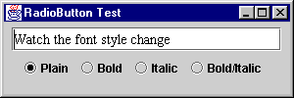
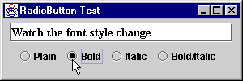
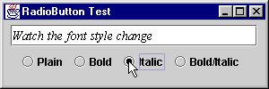
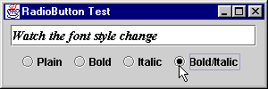

Slide 78
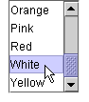
JList
List
  Displays series of items
  may select one or more items
Class JList
  Constructor JList( arrayOfNames )
    Takes array of Objects (Strings) to display in list
  setVisibleRowCount( n )
    Displays n items at a time
    Does not provide automatic scrolling

Slide 79
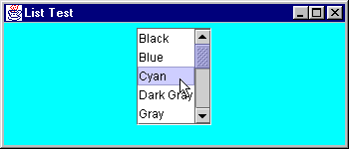
30 // create a list with the items in the colorNames array
31 colorList = new JList( colorNames );
32 colorList.setVisibleRowCount( 5 );
Initialize JList with array of Strings, and show 5 items at a time.
33
34 // do not allow multiple selections
35 colorList.setSelectionMode(
36 ListSelectionModel.SINGLE_SELECTION );
37
38 // add a JScrollPane containing the JList
Make the JList a single-selection list.
39 // to the content pane
40 c.add( new JScrollPane( colorList ) );
41
42 // set up event handler
Create a new JScrollPane object, initialize it with a JList, and attach it to the content pane.
43 colorList.addListSelectionListener(
44 new ListSelectionListener() {
45 public void valueChanged( ListSelectionEvent e )
46 {
47 c.setBackground(
48 colors[ colorList.getSelectedIndex() ] );
49 }
50 }
Change the color according to the item selected (use getSelectedIndex).
51 );
52
53 setSize( 350, 150 );
54 show();
55 }
56
57 public static void main( String args[] )
58 {
59 ListTest app = new ListTest();

Slide 80
1 // Fig. 12.20: MouseDetails.java
2 // Demonstrating mouse clicks and
3 // distinguishing between mouse buttons.
4 import javax.swing.*;
Another example, illustrating mouse events in AWT and Swing
5 import java.awt.*;
6 import java.awt.event.*;
7
8 public class MouseDetails extends JFrame {
9 private String s = "";
10 private int xPos, yPos;
11
Add a listener for a mouse click.
12 public MouseDetails()
13 {
14 super( "Mouse clicks and buttons" );
15
16 addMouseListener( new MouseClickHandler() );
17
18 setSize( 350, 150 );
19 show();
20 }
21
22 public void paint( Graphics g )
23 {
24 g.drawString( "Clicked @ [" + xPos + ", " + yPos + "]",
25 xPos, yPos );
26 }
27

Slide 81
28 public static void main( String args[] )
29 {
30 MouseDetails app = new MouseDetails();
31
32 app.addWindowListener(
33 new WindowAdapter() {
34 public void windowClosing( WindowEvent e )
35 {
Use a named inner class as the event handler. Can still inherit from MouseAdapter (extends MouseAdapter).
36 System.exit( 0 );
37 }
38 }
39 );
40 }
41
42 // inner class to handle mouse events
43 private class MouseClickHandler extends MouseAdapter {
44 public void mouseClicked( MouseEvent e )
45 {
Use getClickCount, isAltDown, and isMetaDown to determine the String to use.
46 xPos = e.getX();
47 yPos = e.getY();
48
49 String s =
50 "Clicked " + e.getClickCount() + " time(s)";
51
52 if ( e.isMetaDown() ) // Right mouse button
53 s += " with right mouse button";
54 else if ( e.isAltDown() ) // Middle mouse button
55 s += " with center mouse button";
56 else // Left mouse button
57 s += " with left mouse button";
58

Slide 82
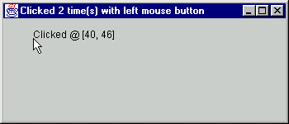
59 setTitle( s ); // set the title bar of the window
60 repaint();
61 }
Set the Frame’s title bar.
Program Output
62 }
63 }

